Slide 1






KONGU ENGINEERING COLLEGE
PERUNDURAI ERODE-638060
DEPARTMENT NAME
KEC IDEATHON
Automatic Water sprinkling
Machine
Team Lead : Siva.K(21BCR051)
Team Members:
Balasubramani.S ( 21BCR004)
Gowtham.G(21BCR014)
Technology Readiness Level: 30%
Team Mentor with Designation and Department:
Dr.S.Karunakaran
Team Co-Mentor with Designation and Department:
In association with:

Slide 2


The Problem
When there is a emergency situation we cannot able to access the motor by physically.
If we cannot able to off the motor in a correct time there would be lot of
water wastage.
Use Images / Photos / Video | Don’t just answer given points in slides | Avoid para | Use bullet points

Slide 3
The Solution
To automation of the watering system we can prevent from water wastage.
By automating the watering system we can control without physically at any time.
Use Images / Photos / Video | Don’t just answer given points in slides | Avoid para | Use bullet points

Slide 4
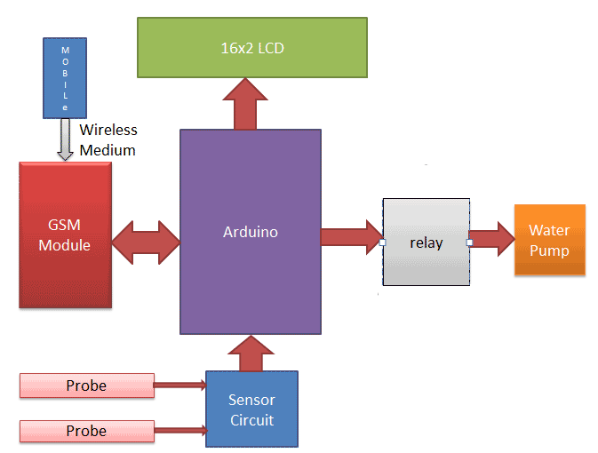
Flowchart / Product workflow
Use Images / Photos / Video | Don’t just answer given points in slides | Avoid para | Use bullet points

Slide 5
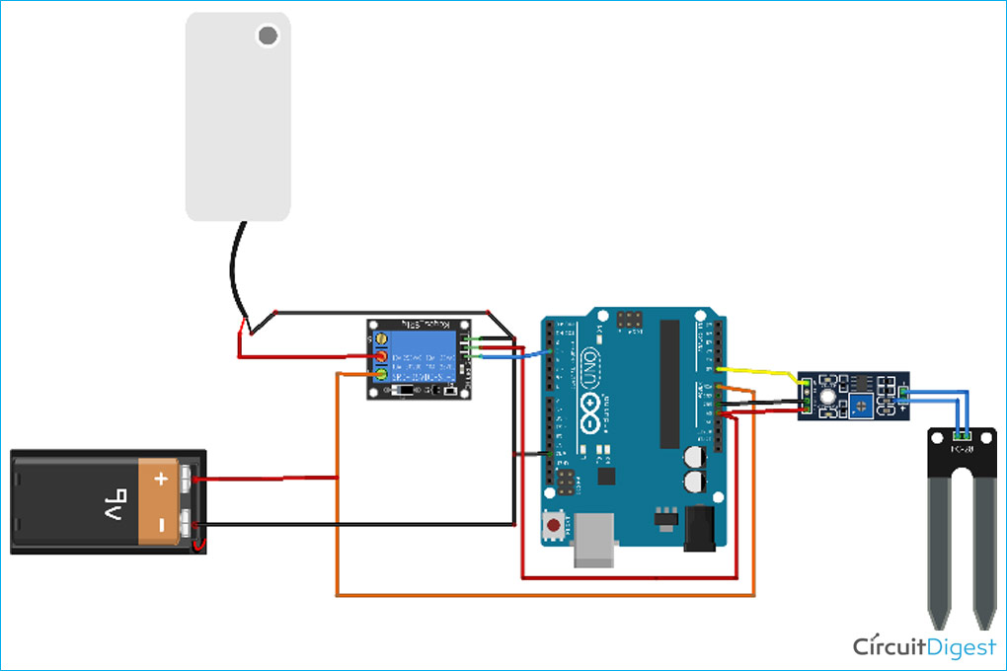

Slide 6
int relayPin =4;
int sensor_pin =A0;
int output_value; void setup(){
Serial.begin(9600);
pinMode(relayPin,OUTPUT);
pinMode(sensor_pin,INPUT);
Serial.println("Reading from sensor...");
delay(2000);
}
void loop(){
output_value = analogRead(sensor_pin);
output_value = map(output_value,550,10,0,100);
Serial.print("Moisture:");
Serial.print(output_value);
Serial.println("%");
if(output_value<20){
digitalWrite(relayPin,LOW);
}
else{
digitalWrite(relayPin,HIGH);
}
delay(1000);
}

Slide 7
Competitors
Telsco Industries Inc.,
HydroPoint Data Systems
Netafim Ltd.,
The Toro Company.
Rachio Inc.
Galcon Ltd.,
Hunter Industries Inc.
Valmont Industries, Inc.
Use Images / Photos / Video | Don’t just answer given points in slides | Avoid para | Use bullet points

Slide 8
Conclusion
The automatic Watering system process is more efficient and workers can concentrate on other important farming tasks.
Use Images / Photos / Video | Don’t just answer given points in slides | Avoid para | Use bullet points

Slide 9
Thank You !!

